Slide 1
Hotel Booking Analytics & Cancellation Analysis
Objective: Analyze booking behavior, cancellation trends, profitability drivers, and provide business recommendations.

Slide 2
Business Problem Statement
1. Understand booking patterns across:
Channels
Room Types
Star Ratings
2. Analyze cancellation behavior.
3.Identify revenue and profitability drivers.
4.Recommend strategies to:
Reduce cancellations
Increase revenue
Improve customer retention

Slide 3
Dataset Information
Total Records- 30,000
Key Fields
Customer ID
Property ID
Booking Dates
Check-In / Check-Out Dates
Room Type
Booking Channel
Revenue Metrics
Refund Information
Booking Status

Slide 4
Data Cleaning Performed Created Views
Confirmed Bookings : (vw_confirmed_bookings)
Used for:
Revenue Analysis
Channel Performance
Room Type Analysis
Valid Stays : (vw_valid_stays)
Used for:
Stay Length Analysis
Lead Time Analysis
Seasonality Analysis

Slide 5
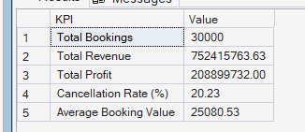
KPI Dashboard
Total Bookings – 30,000
Total Revenue - 752415763.63
Total Profit - 752415763.63
Cancellation Rate - 20.23%
Average Booking Value - 25080.53

Slide 6
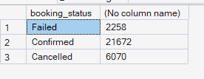
Booking Status Analysis
Insight
72% bookings successfully completed.
20% bookings cancelled.
8% booking failures.

Slide 7
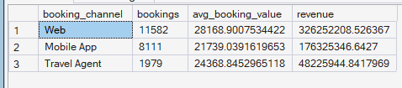
Channel Performance Analysis
Insight
Web Channel:
Highest booking volume.
Highest revenue.
Lowest cancellation rate.
Travel Agent:
Lowest performance.
Highest cancellation rate.

Slide 8
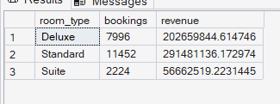
Room Type Analysis
Insight
Standard Rooms:
Drive maximum occupancy.
Higher cancellation risk.
Suites:
Lower volume.
Higher profitability.

Slide 9
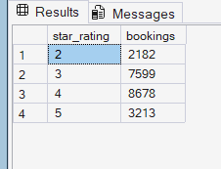
Star Rating Analysis
Insight
4-star hotels provide the best value proposition.
Business Conclusion
Expand partnerships with 4-star properties.

Slide 10
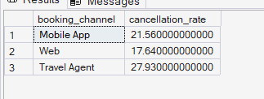
Cancellation Analysis
Root Cause
Flexible cancellation policies.
Duplicate bookings.
Price comparison behavior.

Slide 11
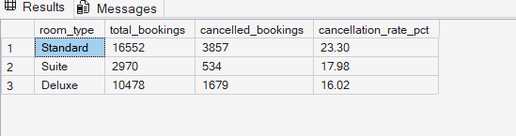
Cancellation by Room Type
Root Cause
Budget-sensitive customers.
High competition.
Price-shopping behavior.

Slide 12
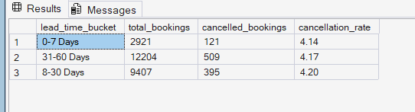
Lead Time Analysis
Insight
Long lead-time bookings show higher cancellation probability.

Slide 13
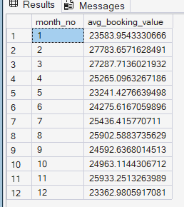
Seasonal Analysis
Monthly Revenue Trend
Findings
Peak Months:
February
March
August
November
Business Interpretation
Likely influenced by:
Holidays
Festivals
Business travel

Slide 14

Stay Length Analysis
Insight
Most guests stay:
2–6 nights
Business Opportunity
Create long-stay discounts.

Slide 15
Root Cause Analysis Summary
Why Are Cancellations High?
Travel Agent Channel
Duplicate reservations
Delayed confirmations
Standard Rooms
Price-sensitive customers
Long Lead Times
Increased plan changes
Premium Hotels
Corporate travel adjustments

Slide 16
Business Recommendations
Reduce Cancellations
Recommendation 1
Introduce non-refundable discounted rates.
Recommendation 2
Require partial prepayment.
Recommendation 3
Automated reminder emails.

Slide 17
Increase Profitability
Recommendation 1
Upsell:
Standard → Deluxe
Recommendation 2
Cross-sell:
Breakfast
Airport Transfers
Room Upgrades
Recommendation 3
Promote premium rooms.

Slide 18
Customer Retention Strategy
Loyalty Program
Example:
3 stays → 5% cashback
Benefits
Repeat bookings
Higher customer lifetime value
Lower acquisition cost

Slide 19
Pricing & Channel Optimization
Dynamic Pricing
Peak Months:
Increase room rates
Low-Demand Months:
Run promotions
Channel Strategy
Increase investment in:
Web
Mobile App
Reduce dependence on:
Travel Agents

Slide 20
Final Conclusion
Key Findings
Web channel is the strongest revenue driver.
Standard rooms generate the highest demand.
4-star hotels dominate bookings.
Cancellation rate is approximately 20%.
Long lead-time bookings are more likely to cancel.
Peak seasons significantly increase revenue.
Strategic Actions
✓ Reduce cancellations through prepayments and reminders.
✓ Focus marketing on direct channels.
✓ Implement dynamic pricing.
✓ Strengthen loyalty programs.
✓ Upsell premium room categories.

Slide 21
THANK YOU

